Slide 1

Trees in the R environment
RPM 2017
DIY analysis with open source software

Slide 2
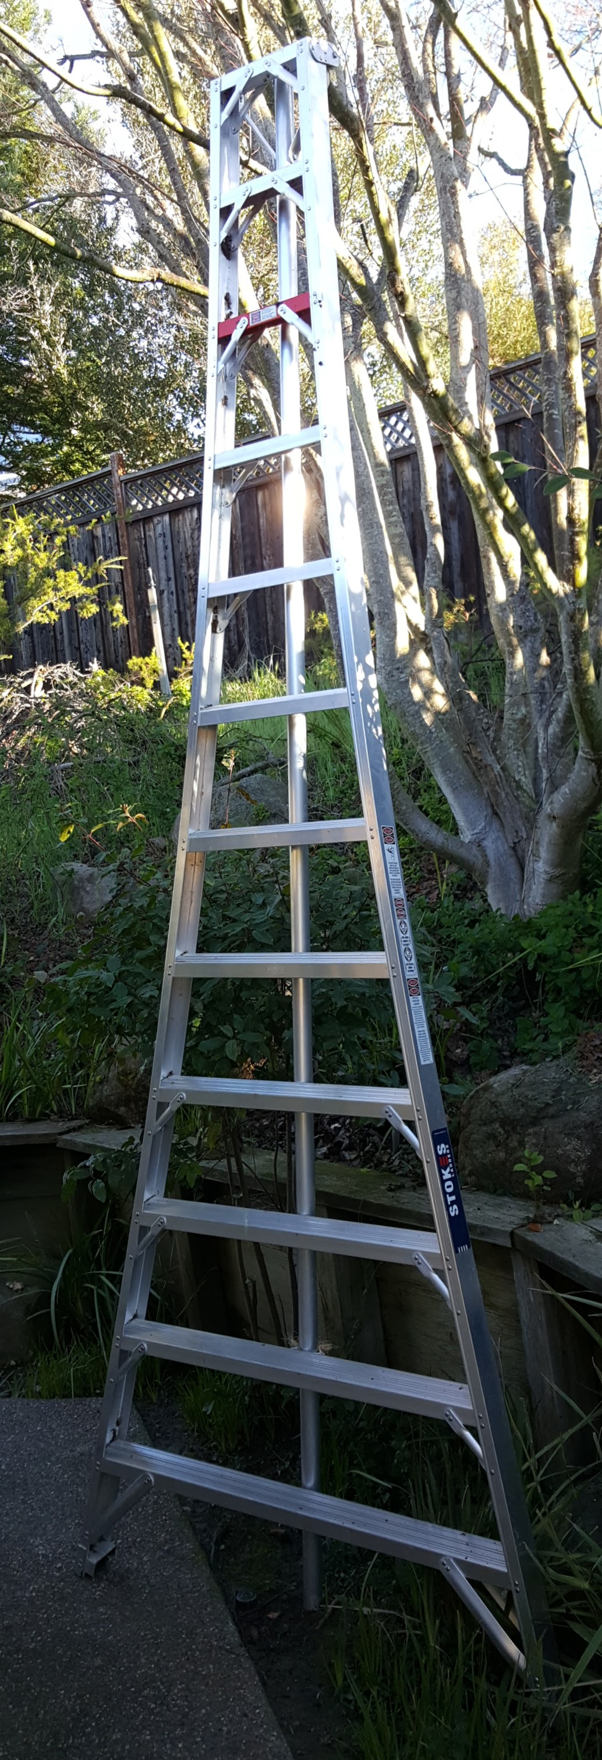
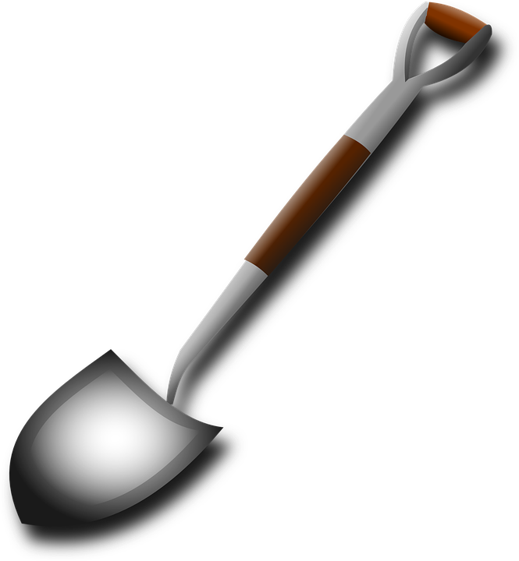
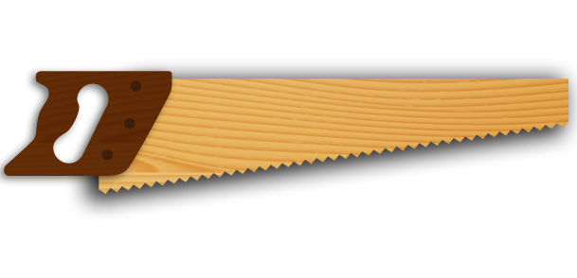
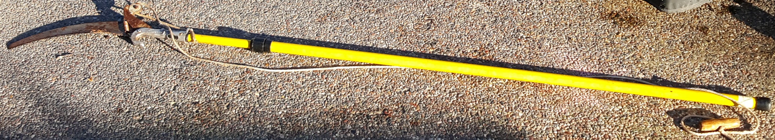
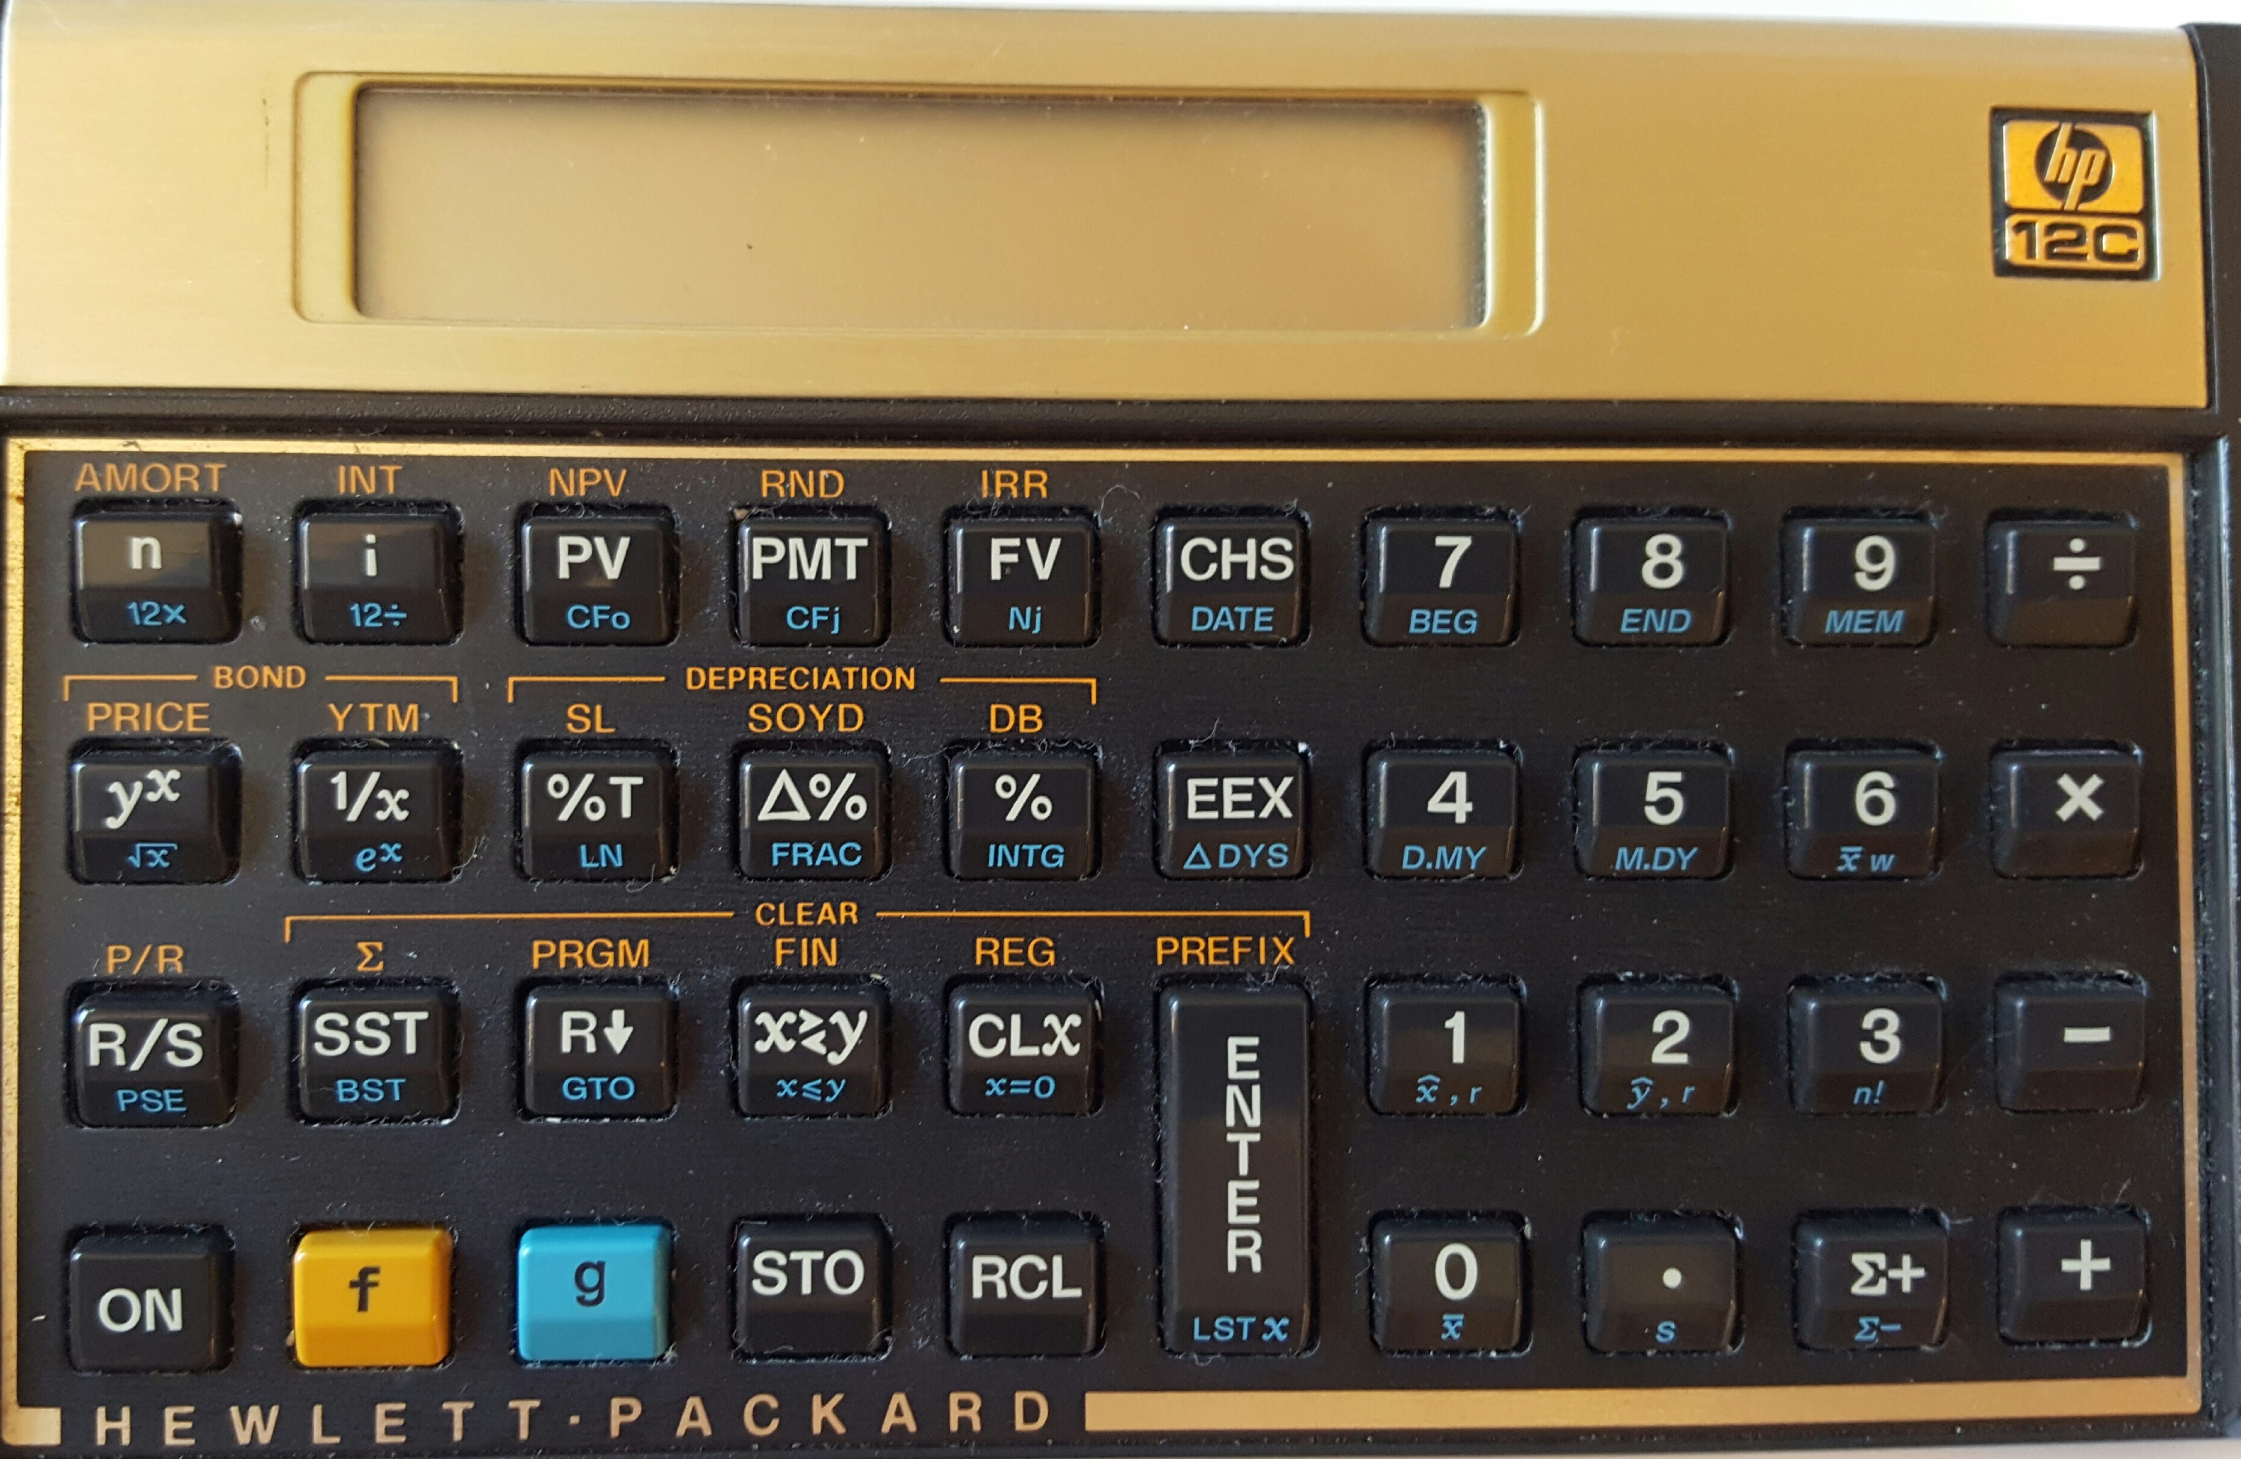
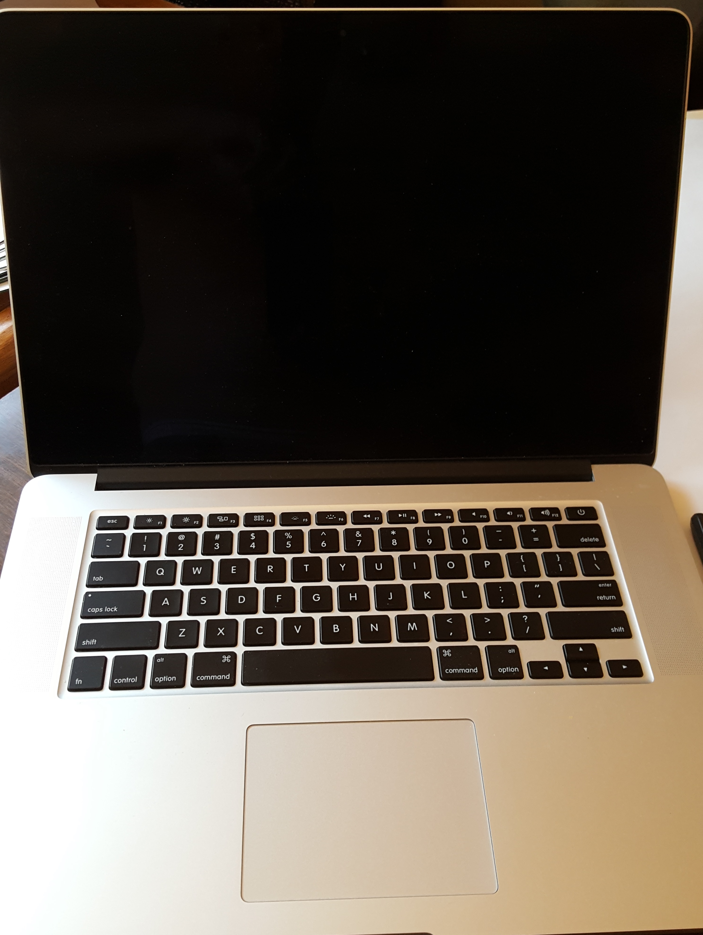
Modelers are builders and use tools
Per Merriam-Webster a tool is
A handheld device that aids in accomplishing a task
An apparatus used in the practice of a vocation or profession
Notes:
http://www.merriam-webster.com/dictionary/tool for first two
http://www.urbandictionary.com/define.php?term=tool

Slide 3



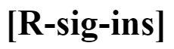









The R Environment is a collection of tools

Slide 4
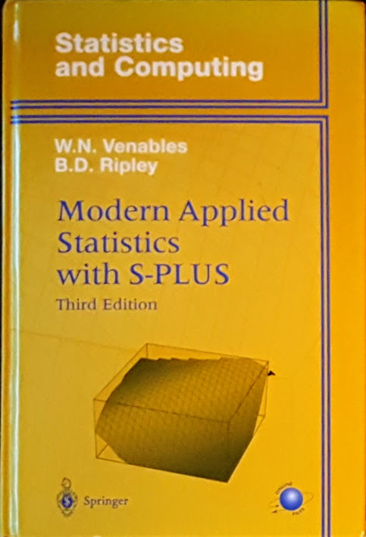
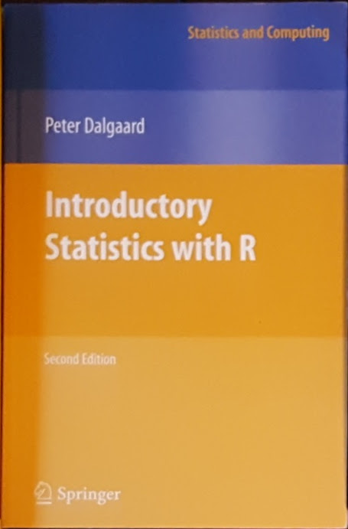


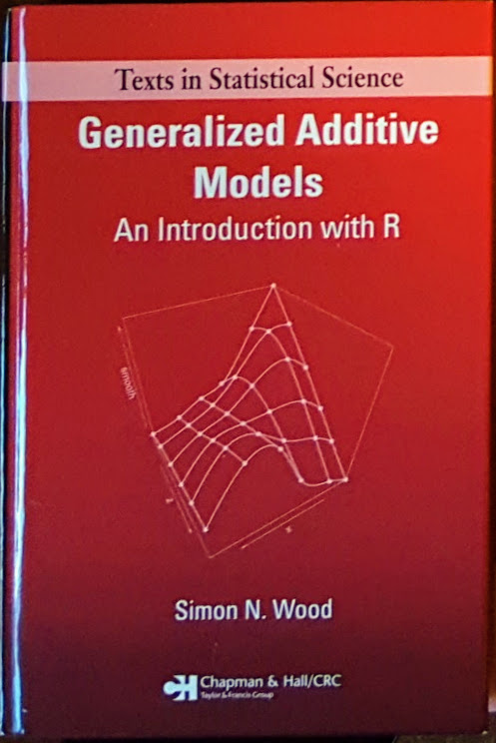



Learn statistics with R

Slide 5

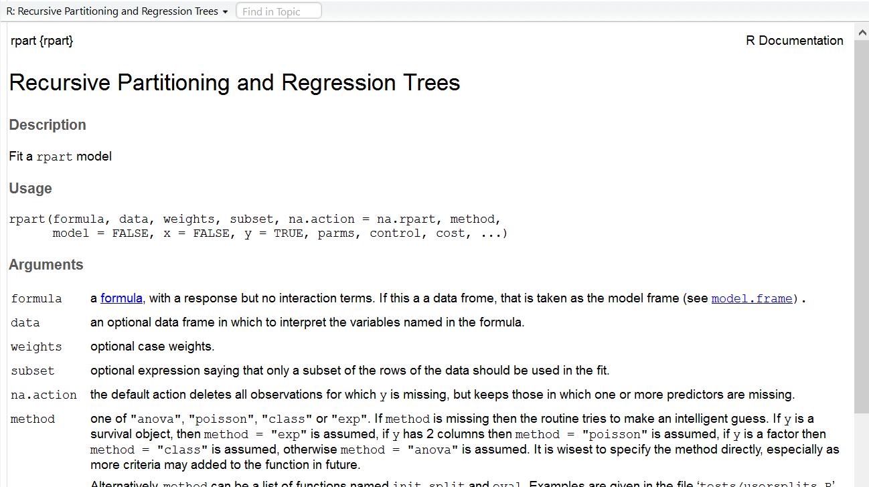
rpart help

Slide 6
Recursive PARTitioning
Because CART is the trademarked name of a particular software implementation of these ideas, and tree has been used for the SPlus routines of Clark and Pregibon [2] a different acronym — Recursive PARTitioning or rpart — was chosen. It is somewhat humorous that this label “rpart” has now become more common than the original and more descriptive “cart”, a testament to the influence of freely available software.

Slide 7
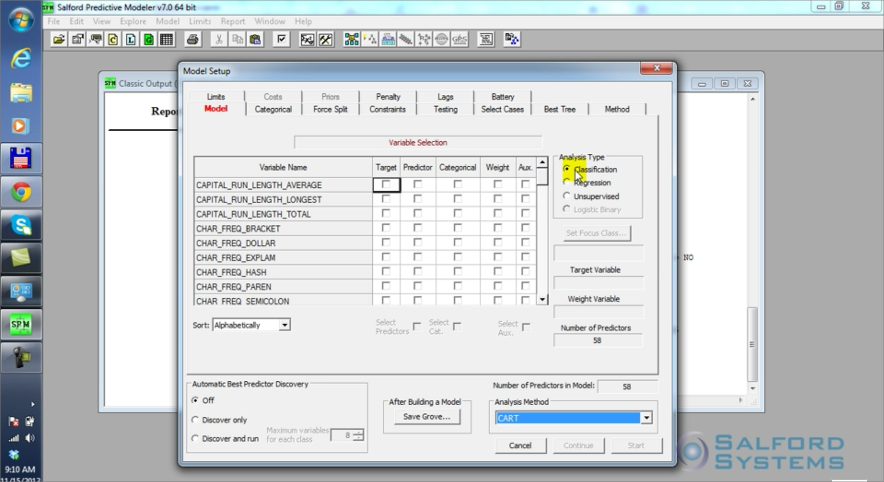
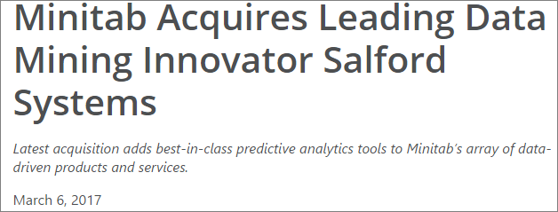
An alternative

Slide 8
rpart in action/detail
Start RStudio
Load the rpart library
Load the data
Do your thing
Notes:
(Matt Dowle story – can you make a u turn here)

Slide 9
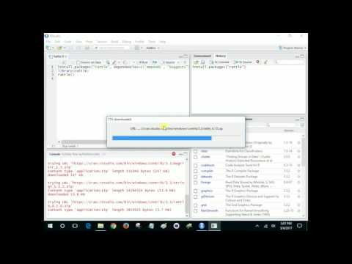
Run R/Rstudio/Rattle from USB drive
Copy profile to folder with R code
Double-click starts RStudio, opens file
Install the Rattle package using RStudio’s gui
Load the library and start Rattle
Keep installing necessary packages until Rattle runs w/o error
Notes:
(Matt Dowle story – can you make a u turn here)

Slide 10
Splitting the data with a shiny app

Slide 11
Building the formula with a shiny app

Slide 12
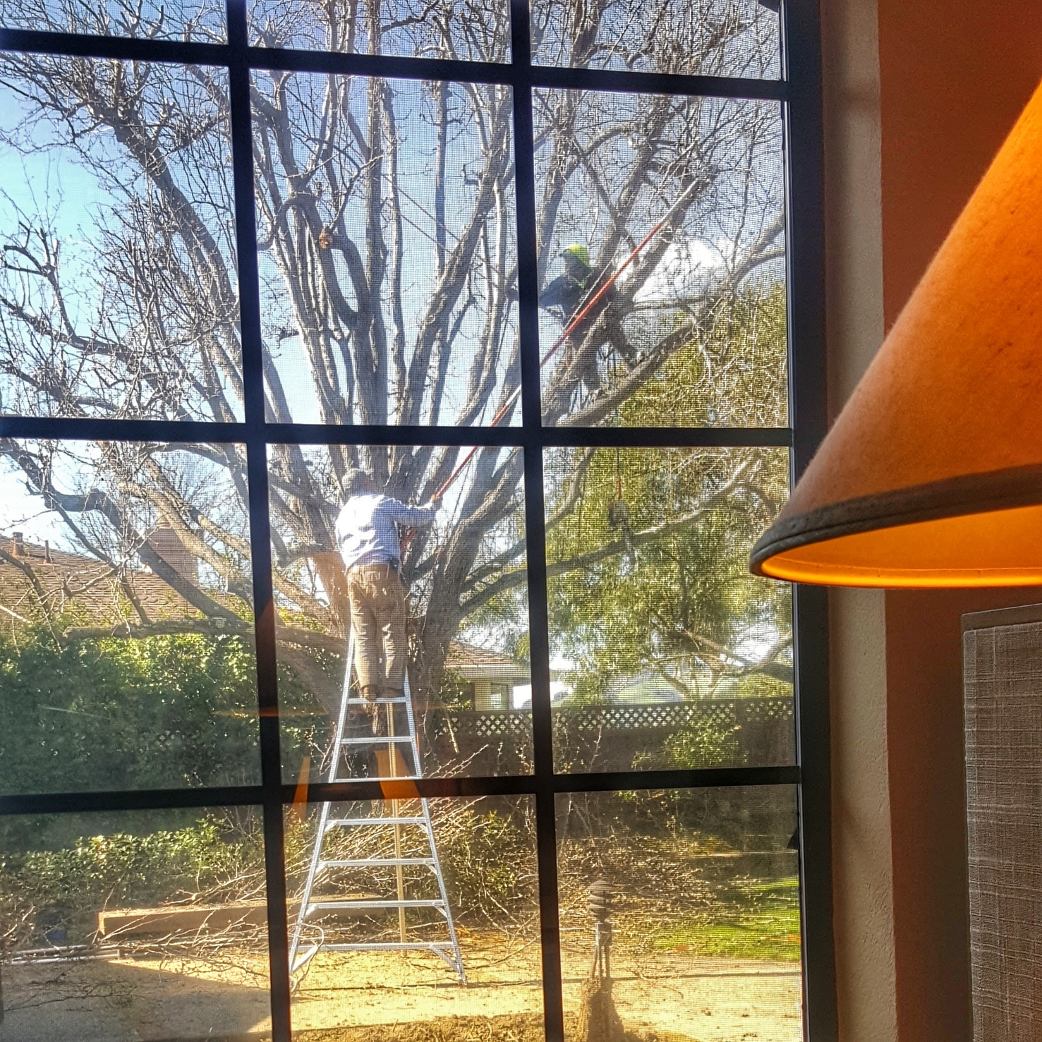
Contact me if questions
Dan Murphy
dmurphy@trinostics.com
Trinostics LLC, San Francisco
https://www.triknowbits.com/
https://cran.r-project.org/
https://www.rstudio.com/
https://www.salford-systems.com/

